Slide 1
Project Title: Sales Performance Analysis of Walmart Stores Using Advanced MySQL Techniques
by, Tushar R

Slide 2
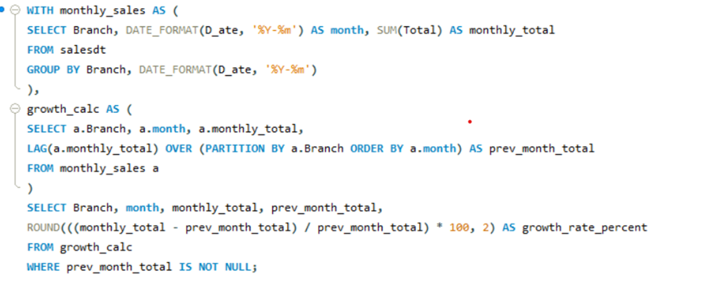
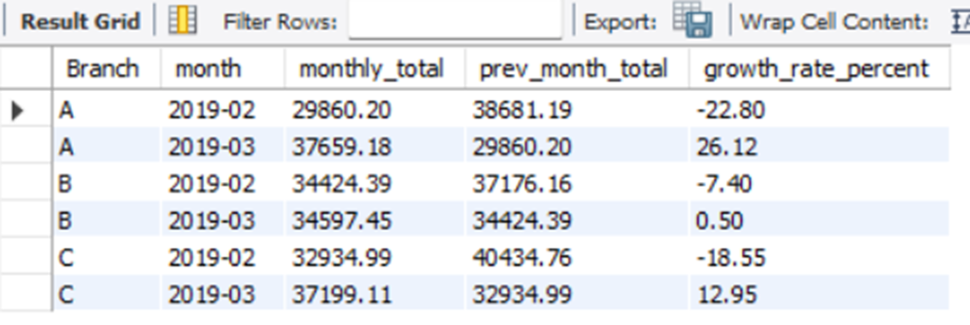
Task 1: Identifying the Top Branch by Sales Growth Rate
Input query
Output

Slide 3

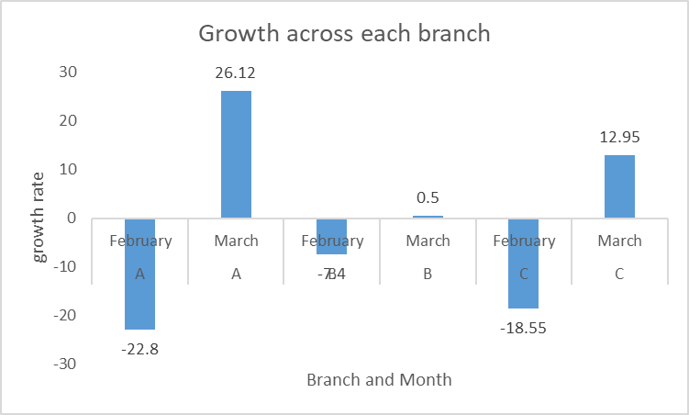
Analysis of monthly sales growth by branch
Branch A: Positive momentum is indicated in March with a strong rebound of +26.12% growth after a -22.80% dip in February.
Branch B: Fairly stable with minimal fluctuation. Small decline in February (-7.40%) followed by a slight recovery (+0.50%) in March.
Branch C: Saw a precipitous decline in February (-18.55%), suggests a decline in consumer traffic or potential operational problems

Slide 4
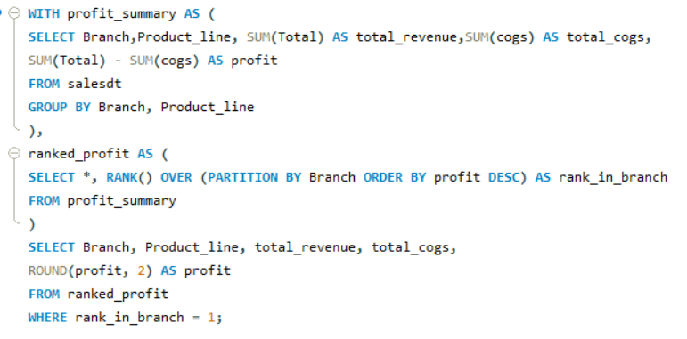

Task 2: Finding the Most Profitable Product Line for Each Branch
Input query
Output

Slide 5

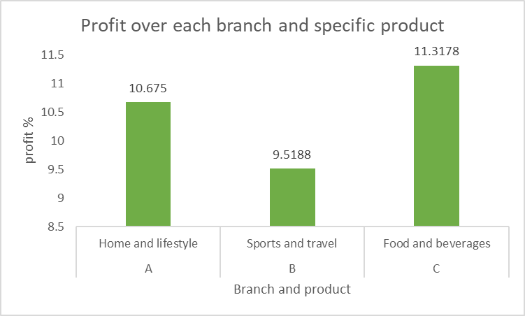
Best-selling items in each branch
Branch A: Top product line: Home and lifestyle. Good to increase inventory and advertisements
Branch B:Top product line: Sports and travel. Increase variety of items in the line and advertise travel plans and vacations.
Branch C: Top product line: Food and beverages. Keps the inventory full. Adding new items in the same line to see the trend

Slide 6
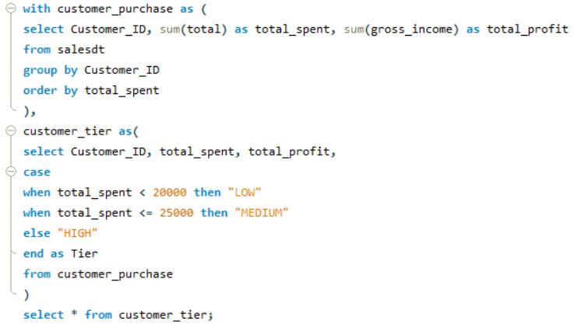
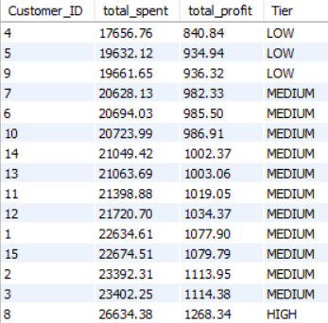
Task 3: Analyzing Customer Segmentation Based on Spending
Input query
Output

Slide 7
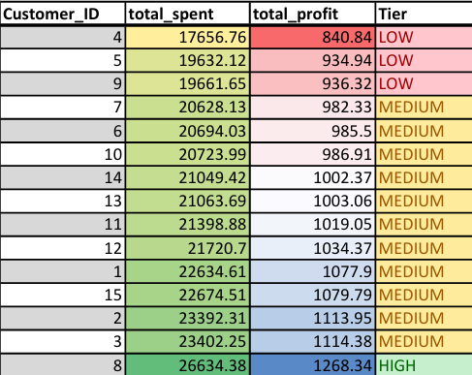

Let’s identify who our premium customer(s) are
Criteria used in tier based on total spent
<20000 -> LOW
<=25000 -> MEDIUM
>25000 -> HIGH

Slide 8
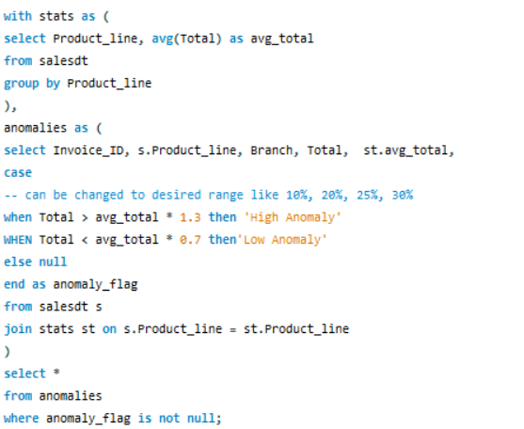
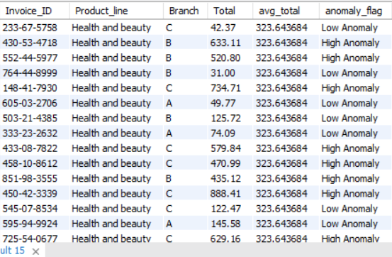
Task 4: Detecting Anomalies in Sales Transactions
Input query
Output
Anomaly range is 土30%

Slide 9
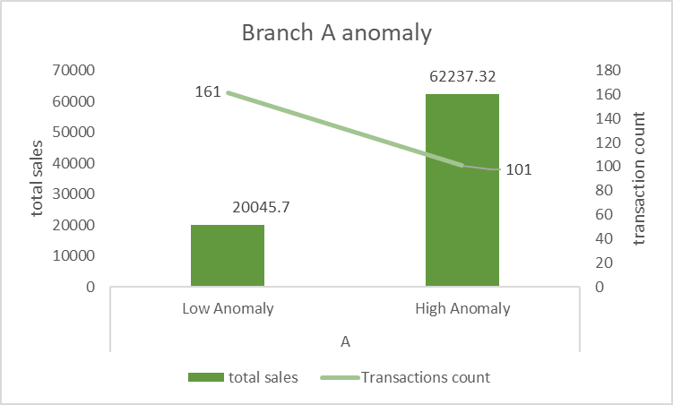
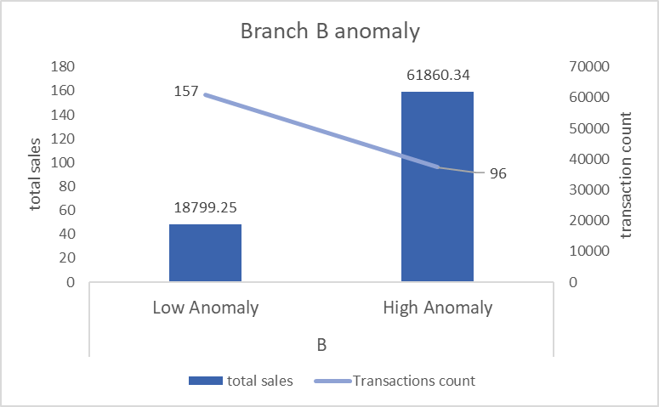
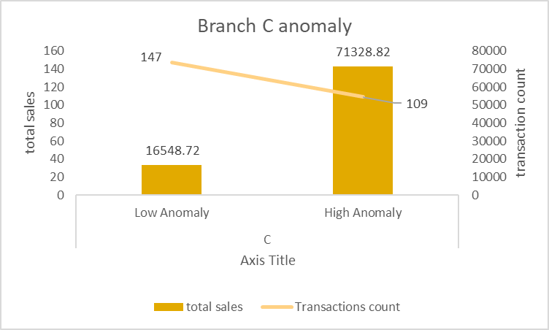
Comparing anomalies in various Branches
Branch A shows a high concentration of high anomaly transactions, indicating possible bulk purchases or pricing issues.
Branch C recorded the highest total sales from high anomalies, potentially driven by a few unusually large transactions.

Slide 10
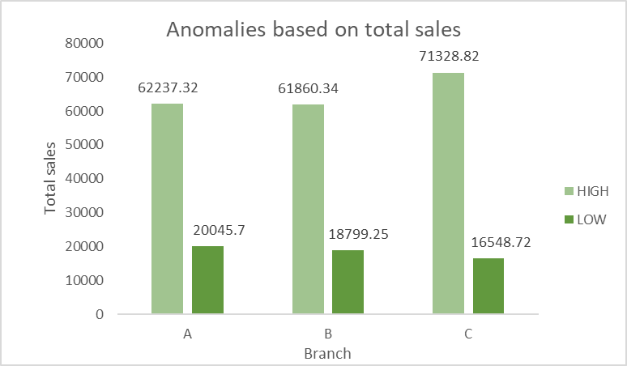
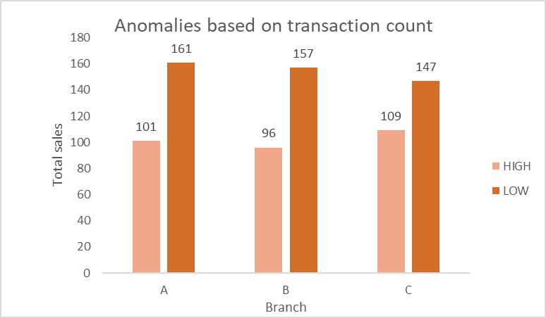
Branch-Wise Analysis of High and Low Sales Anomalies
High anomaly transactions contribute significantly to total revenue, especially in Branch C.
Low anomalies may point to underperforming products or discount-driven purchases.
Patterns vary by branch, suggesting location-specific sales behaviors or operational differences.
Ongoing monitoring of anomalies can enhance fraud detection, inventory management, and targeted marketing efforts.

Slide 11

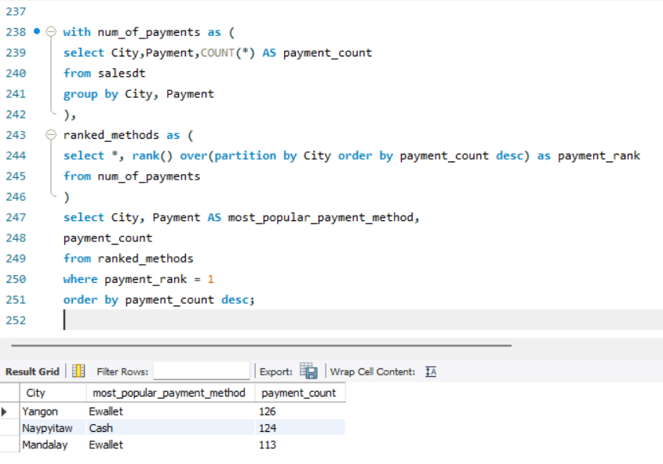
Task 5: Most Popular Payment Method by City
Input query
Output
City | Popular payment mode
Mandalay | Ewallet
Naypyidaw | Cash
Yangon | Ewallet

Slide 12
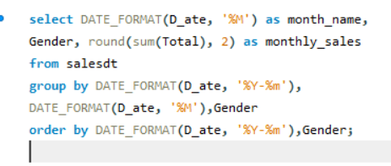
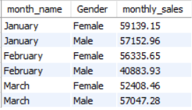
Task 6: Monthly Sales Distribution by Gender
Input query
Output

Slide 13
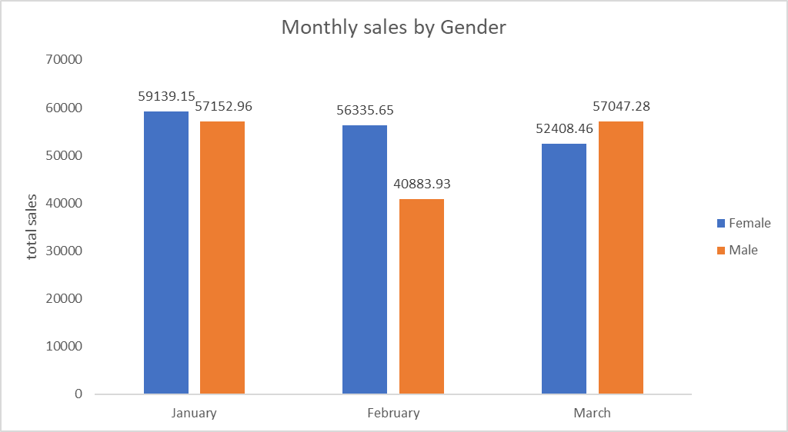
Monthly sales broken out by gender

Slide 14
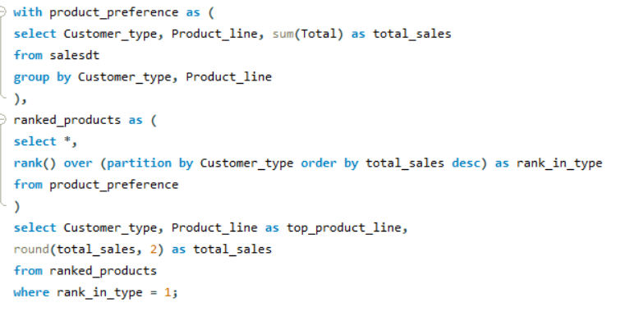

Task 7: Best Product Line by Customer Type
Input query
Output

Slide 15
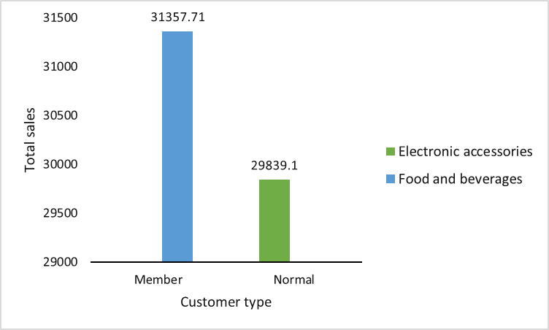
Which product categories do different types of customers prefer?

Slide 16
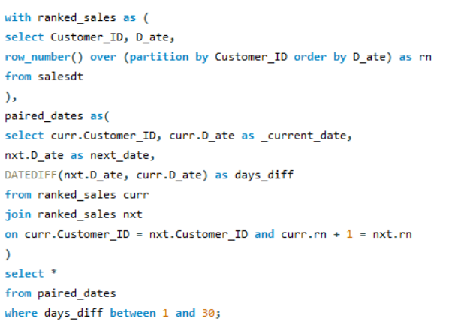
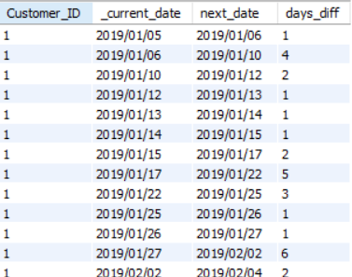
Task 8: Identifying Repeat Customers
Input query
Output

Slide 17

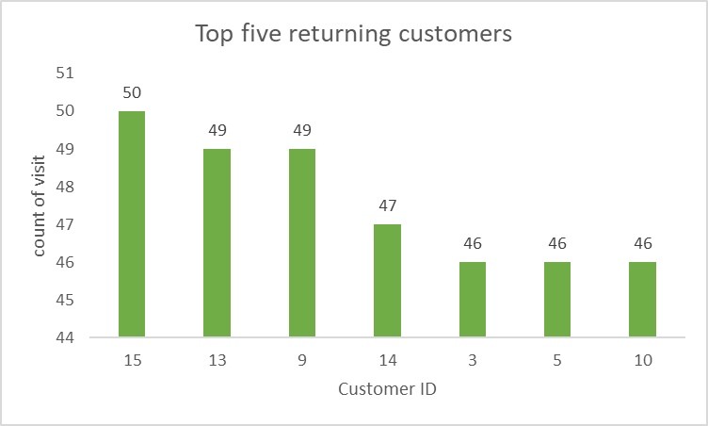
Who visits more frequently?
Top five spending Customer_IDs
8
3
2
15
1

Slide 18
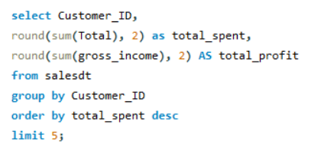
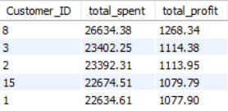
Task 9: Finding Top 5 Customers by Sales Volume
Input query
Output

Slide 19
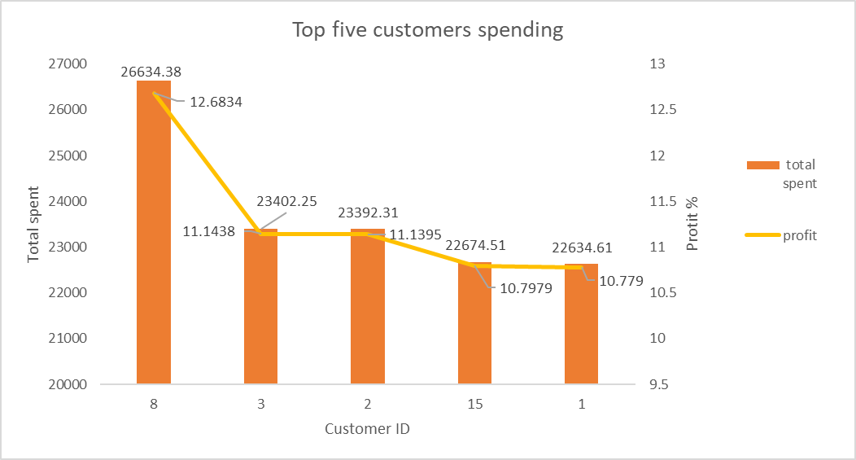
Overall sales and profits generated by top five customers
Customer_ID | total_spent | profit %
8 | 26634.38 | 12.6834
3 | 23402.25 | 11.1438
2 | 23392.31 | 11.1395
15 | 22674.51 | 10.7979
1 | 22634.61 | 10.779

Slide 20
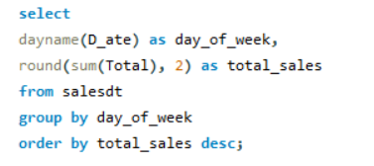
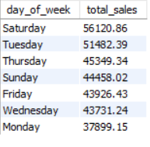
Task 10: Analyzing Sales Trends by Day of the Week
Input query
Output

Slide 21

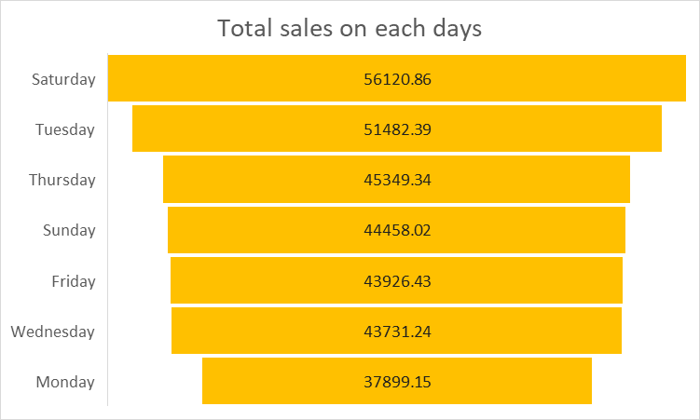
Sales on various days of week

Slide 22

Conclusions
Branch A has higher sales growth compared to B and C.
A- Home and fashion.
B- sports and travel.
C- Food and beverages.
Customer_ID- 8 has purchased over $25000.
Female customers made more purchases compared to male.
Customers with membership tend to spend more on food and beverages
Customer_IDs 3, 5, 9, 10, 13, 14, 15 visits more frequently.
Customer_IDs 1, 2, 3, 8, 15 are top 5 spending customers
Saturdays tend to be the busiest days
Customer_Id - 8 can be given special coupons and gifts.
Video link for project_4

Slide 23


